Slide 1
Creating effective Student Learning Outcomes* General Assessment Strategies, Part I
Program Assessment
Core Assessment
Course Assessment
*excerpted from Higher Learning Commission’s Assessing General Education, February 27-28, 2019
Notes:
Would also like to share what we learned while attending the Higher Learning Commission’s conference on Assessing general education.
Would like to do a post mortem analysis on our first attempt at assessing SLO #1 of the Core Curriculum

Slide 2
Notes:
One of the first mistakes we realized was that we are often trying to assess everything….

Slide 3
GOAL
Student Learning Outcome
Performance indicator #1
Performance indicator #2
Performance indicator #3
Creating effective learning outcomes requires us to think on three different levels.
Getting this clear is more than half the battle!
Notes:
A second mistake was that we did not have a clear and workable method for assessment

Slide 4
I. GOALS
Broad concepts or categories of expected learning
What do we expect ALL Calvin <Sociology> majors to know and be able to do when they graduate?
What do we expect ALL Calvin students to know and be able to do when they graduate?
Notes:
What does a Calvin student look like?

Slide 5
Goals at Calvin College
At Calvin, our goals are defined by our missional documents, most notably our Educational Framework
https://calvin.edu/academics/educational-outcomes/

Slide 6
Goals have many purposes.
Learning outcomes and performance indicators are ONLY for assessment.
Aspirational Workhorse
Broad Narrow
General Precise
Abstract Concrete
Non-falsifiable Falsifiable
Goals Learning Outcomes

Slide 7
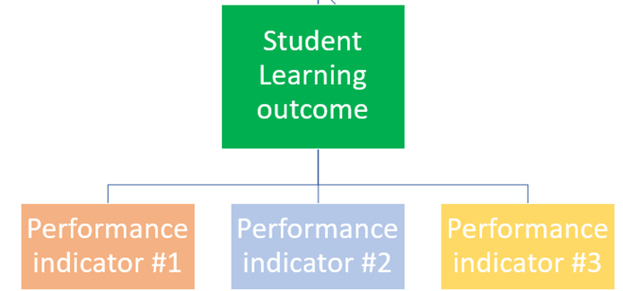
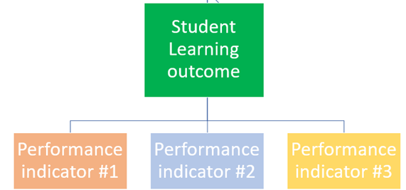
GOALS
(Educational Framework)

Slide 8
II. Student Learning Outcomes
Specific statements of what students will know or do as the result of study in an academic program
The Core Curriculum is an academic program

Slide 9
FORMAT OF A STUDENT LEARNING OUTCOME
Students should be able to
<action verb> <something>
NOT ALLOWED:
Commas
The following words:
And
Or
Learn
Know
Understand
7 (9%) of Core Student Learning Outcomes at Calvin meet this standard

Slide 10
KNOWLEDGE | COMPREHENSION | APPLICATION | ANALYSIS | SYNTHESIS | EVALUATION
Cite | Associate | Apply | Analyze | Arrange | Appraise
Count | Classify | Calculate | Appraise | Collect | Assess
Define | Compare | Classify | Calculate | Compose | Choose
Draw | Compute | Demonstrate | Categorize | Construct | Compare
Identify | Contrast | Determine | Classify | Create | Criticize
List | Differentiate | Dramatize | Compare | Design | Determine
Name | Discuss | Employ | Debate | Formulate | Estimate
Point | Distinguish | Examine | Diagram | Integrate | Evaluate
Quote | Estimate | Illustrate | Differentiate | Manage | Grade
Read | Explain | Interpret | Distinguish | Organize | Judge
Recite | Express | Operate | Examine | Plan | Measure
Record | Extrapolate | Order | Experiment | Prepare | Rank
Repeat | Interpolate | Practice | Inspect | Prescribe | Rate
Select | Locate | Report | Inventory | Produce | Recommend
State | Predict | Restructure | Question | Specify | Revise
Tabulate | Report | Schedule | Separate | Synthesize | Score
Tell | Restate | Sketch | Summarize | Write | Select
Trace | Review | Solve | Test |  | Standardize
Underline | Tell | Translate |  |  | Validate
 | Translate | Use
 |  | Write

Slide 11
KNOWLEDGE | COMPREHENSION | APPLICATION | ANALYSIS | SYNTHESIS | EVALUATION
Cite | Associate | Apply | Analyze | Arrange | Appraise
Count | Classify | Calculate | Appraise | Collect | Assess
Define | Compare | Classify | Calculate | Compose | Choose
Draw | Compute | Demonstrate | Categorize | Construct | Compare
Identify | Contrast | Determine | Classify | Create | Criticize
List | Differentiate | Dramatize | Compare | Design | Determine
Name | Discuss | Employ | Debate | Formulate | Estimate
Point | Distinguish | Examine | Diagram | Integrate | Evaluate
Quote | Estimate | Illustrate | Differentiate | Manage | Grade
Read | Explain | Interpret | Distinguish | Organize | Judge
Recite | Express | Operate | Examine | Plan | Measure
Record | Extrapolate | Order | Experiment | Prepare | Rank
Repeat | Interpolate | Practice | Inspect | Prescribe | Rate
Select | Locate | Report | Inventory | Produce | Recommend
State | Predict | Restructure | Question | Specify | Revise
Tabulate | Report | Schedule | Separate | Synthesize | Score
Tell | Restate | Sketch | Summarize | Write | Select
Trace | Review | Solve | Test |  | Standardize
Underline | Tell | Translate |  |  | Validate
 | Translate | Use
 |  | Write
Suitable for Beginning Courses and Core
Learning Outcomes

Slide 12
KNOWLEDGE | COMPREHENSION | APPLICATION | ANALYSIS | SYNTHESIS | EVALUATION
Cite | Associate | Apply | Analyze | Arrange | Appraise
Count | Classify | Calculate | Appraise | Collect | Assess
Define | Compare | Classify | Calculate | Compose | Choose
Draw | Compute | Demonstrate | Categorize | Construct | Compare
Identify | Contrast | Determine | Classify | Create | Criticize
List | Differentiate | Dramatize | Compare | Design | Determine
Name | Discuss | Employ | Debate | Formulate | Estimate
Point | Distinguish | Examine | Diagram | Integrate | Evaluate
Quote | Estimate | Illustrate | Differentiate | Manage | Grade
Read | Explain | Interpret | Distinguish | Organize | Judge
Recite | Express | Operate | Examine | Plan | Measure
Record | Extrapolate | Order | Experiment | Prepare | Rank
Repeat | Interpolate | Practice | Inspect | Prescribe | Rate
Select | Locate | Report | Inventory | Produce | Recommend
State | Predict | Restructure | Question | Specify | Revise
Tabulate | Report | Schedule | Separate | Synthesize | Score
Tell | Restate | Sketch | Summarize | Write | Select
Trace | Review | Solve | Test |  | Standardize
Underline | Tell | Translate |  |  | Validate
 | Translate | Use
 |  | Write
Suitable for Program Learning Outcomes

Slide 13
To review, learning outcomes have…
ONE action verb
ONE substantive concept
And they must be able to be finished with the imaginary phrase:
“As evidenced by…”

Slide 14
Examples of Good Program Learning Outcomes
Apply ancient wisdom to current problems
01
Communicate effectively to specific audiences
02
Contrast two distinct Christian perspectives in <Nursing>
03
Develop models of algorithmic thinking
04

Slide 15
Examples of less effective Course Learning Outcomes* * taken from an anonymous Psychology faculty’s Lifespan Development syllabus
Consider
Consider how biological, social, and cultural factors impact development in infancy, childhood, and adolescence
Understand
Understand how moments in history have shaped human development in the USA and other countries
Know
Know how children’s language (verbal and nonverbal) unfolds in both typical and atypical environments
Understand
Understand Christian perspectives on these topics

Slide 16
Examples of improved Course Learning Outcomes* * these are statements about the overall course, but they are capable of guiding assessment. Several performance indicators can be applied to each learning outcome
Consider
Explore the nature/nurture debate across the lifespan
Understand
Understand how moments in history have shaped human development
Know
Apply several developmental theories to specific life events
Understand
Debate how temperament relates to concepts of agency and discipleship

Slide 17
Notes:
With program review, you might change up outcomes if students have consistently met a threshold for years

Slide 18
III. Performance Indicators
Precise and measurable statements identifying student performances required to meet a given outcome; confirmable through evidence
Provide a common language for faculty
Shared across a department or institution
Provides faculty with clear direction for implementation
Makes expectations explicit to students

Slide 19
GOAL
Student Learning Outcome
Performance indicator #1
Performance indicator #2
Performance indicator #3

Slide 20
Educational framework
Communicate effectively to specific audiences
Oral speech
Presentation style
Content
Organization
Learning Demonstration
Connection to audience
Content
Logical Flow
Group presentation
Delivery
Teamwork
Mastery of content

Slide 21
Examples of Good Performance Indicators
Demonstrate competency in a language other than English at the level commensurate with a 4th-semester course, according to national standards.
Successfully explain the process of informed consent to individuals with cognitive impairments.
Debate whether the concept of confirmation bias is consistent with Christian notions of agency and original sin.
Apply a One-Way ANOVA analysis to an experimental design.

Slide 22
A Sample Case: Revising Lifespan Development PSYCH 201

Slide 23
SLOS too complicated to guide assessment
Are not helpful for course evaluation purposes
Provides no value to student, faculty or department
Contained non-falsifiable statements
Vague statements

Slide 24
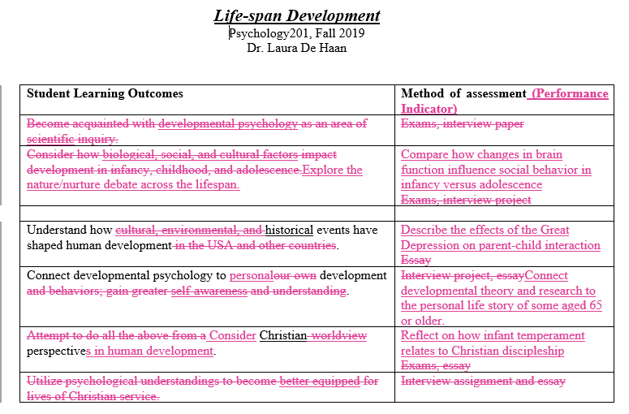
SLOs now have:
One action verb and substantive concept
Can guide assessment but are SEPARATE from the assessment tool
Can be used as a common language for faculty

Slide 25
Laura DeHaan will assess one or more of these indicators in Fall 2019, and she changes these indicators to reflect current assessment questions and/or needs
Voila!
Everyone who teaches Lifespan will have same Student Learning Outcomes

